Slide 1
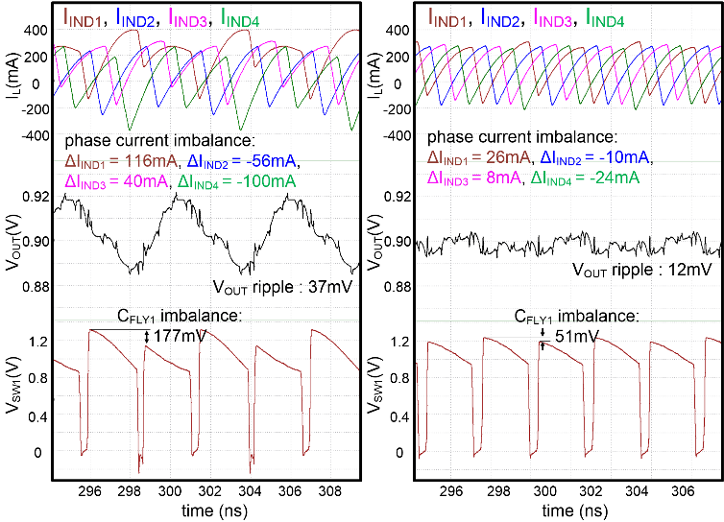
2020 IDEC CDC
Balancing scheme for phase current and flying-capacitor voltage in 3-level DC-DC converter
Chan-Ho Kye, Minho Choi, and Deog-Kyoon Jeong
Department of Electrical and Computer Engineering, Seoul National University
Abstract: The proposed balancing scheme based on the ripple voltage of the flying capacitor can simultaneously mitigate the imbalance of phase current and voltage of the flying capacitor. A prototype 4-phase 350-MHz 3-level DC-DC converter shows less than 4.7% voltage imbalance of the flying capacitor and less than 36-mA phase-current imbalance at output voltage and maximum load current of 0.9V and 1.2A, respectively.
4-phase 3-level buck converter
Circuit implementation
CFLY voltage and phase current balancing scheme using CFLY ripple voltage sensors is proposed.
4-phase 3-level DC-DC converter with a very high switching frequency is fully integrated.
The switched capacitor circuits are used to sample the VSW according to the sampling clock signals QS1 and QS2.
The QS1 and QS2 are generated by the timing generator that reflects the delay of Δt equal to the delay of the gate driver.
Since the sensor can measure the ripple voltage by distinguishing the charging operation from the discharging operation, the controller separately senses the ripple voltage during the charging and discharging.
Steady-state waveforms
Imbalance of the flying capacitor
If the converter controls the ripple voltage of CFLY, the flying-capacitor voltage can be balanced.
The ripple voltage of CFLY can be used not only for the voltage balance of CFLY but also for phase balance of the multi-phase converter without additional current sensors.
Simulation results
4-phase 3-level
65-nm CMOS
Flying capacitor: 2nF
Output capacitor: 7.2nF
Switching frequency: 350 MHz
Unbalanced phase current and CFLY voltage cause not only a reliability issue but also a large output-voltage ripple.
Proposed balancing scheme reduces the output-voltage ripple by about one third.
Proposed balancing scheme reduces the CFLY voltage imbalance from 14.8% to 4.7% and the maximum phase-current imbalance from 116 mA to 36 mA.
CFLY and phase current balancing controller
The average current information, VSEN, is added to the saw-tooth signal, VSAW, to balance the CFLY voltage and the inductor current for all phases.
The CFLY ripple voltage sensor generates the sensing voltage, VSEN, based on the VSW which reflects the flying capacitor voltage.
Conclusion: We have proposed a novel balancing scheme for phase current and CFLY voltage for a very high-frequency IVR. The proposed balancing technique improves device reliability as well as the regulated output-voltage characteristic. The proposed CFLY ripple voltage sensor simultaneously obtains the average current information of CFLY and the inductor of the converter operating at the switching frequency of 350 MHz. The proposed scheme reduces the phase-current imbalance and CFLY voltage imbalance down to about 31% and 32%, respectively.
Acknowledgement: We thank to IDEC for fabrication support.

